Slide 1
Scientific Science Writing
Baisic Training, Spring 2012
Eun-Ah Kim
Thanks to Chris Henley and others for materials.
References:
The science of scientific writing, American Scientist
http://www.americanscientist.org/issues/num2/the-science-of-scientific-writing/1
Lecture notes from scientific writing course at stanford. www.stanford.edu/~kcobb

Slide 2
Why lecture on writing?
"In science, the credit goes to the man who convinces the world, not to the man to whom the idea first occurs." _{-- Sir Francis Darwin}
"Writing is an art. But when it is writing to inform it comes close to being a science as well.” --Robert Gunning,The Technique of Clear Writing

Slide 3
David Mermin, “Writing Physics”
…you don't understand the real significance of the research you've been struggling with for the past year, until you begin to write about it. Only then do you realize that it is much more interesting (or, if you're unfortunate and uncommonly honest, much less interesting) than you'd thought. Only then do you really see how your work fits into or, if you are lucky, changes the character of the tradition out of which it grew.

Slide 4
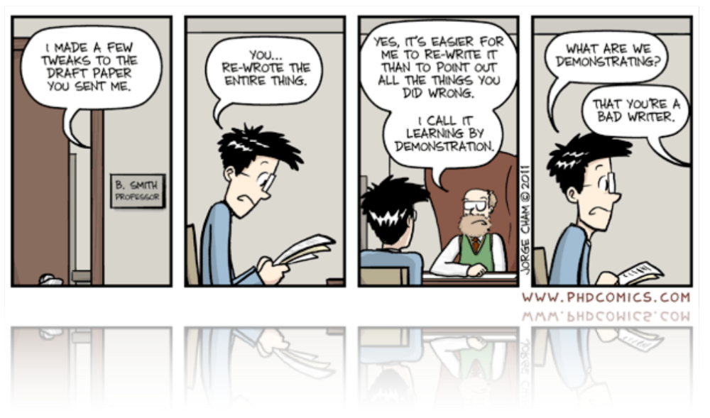
My graduate student days
My first draft
PhD Comics - Jorge Cham 09/14/11
Sin 1: procrastination
Sin 2: arrogance “I can get it right in one go.”
Sin 3: faith in all-nighter

Slide 5
My Goal:
a basic recipe !
Effective work flow.
Breaking down the ill-defined and intimidating project of “write-up” into sequence of steps.
Lowering the barrier against writing and re-writing.

Slide 6
4-lecture series
Macroscopic and microscopic structures
How to plan and use an outline
Practical how-to: From outline to abstract, figures, tables and paragraphs.
Rewriting at macroscopic and microscopic scales.

Slide 7
HW collection and feedback
Short exercises during and/or after each lecture
You are welcome to submit exercises for feedback
Notes:
Demo blackboard

Slide 8
Our expectations
Have something to say and say it logically.
Hold reader’s attention.
Notes:
Demo prl

Slide 9
How to be successful
in producing a readable
and exciting scientific article?

Slide 10
Plan and implement
What do you want to say? (Did you say it?)
Logical story telling. Like ideas should be grouped. Like paragraphs should be grouped.
Don’t “bait-and switch” your readers.
  Takes away opportunity for critical reading.
  Leaves reader unsatisfied.

Slide 11
Cater to Reader’s needs
Structure of a paper.
Structure of paragraphs.
Structure of setences.
Structure of figures and captions.
Structure of equations.
Structure of tables.

Slide 12
Grading writing aspects [10]
Outline 5
  a message statement
  one bullet point for each paragraph
  Built in list of Figures
One missing element in the abstract -1
A figure not following the figure guideline -1
A paragraph without a topic sentence -1
A un-necessary paragraph -1

Slide 13
Importance of Structure

Slide 14
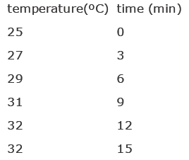
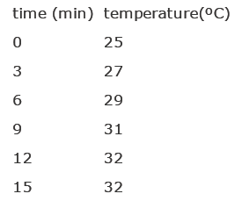
Structure v.s. Substance
Context (left) for interpreting the significant information (right)
We read from left to right.
We expect context on the left, new, important information on the right.

Slide 15
Structure affects interpretation
Readers have expectation for structure.

Slide 16
What is wrong with this paragraph?
Large earthquakes along a given fault segment do not occur at random intervals because it takes time to accumulate the strain energy for the rupture. The rates at which tectonic plates move and accumulate strain at their boundaries are approximately uniform. Therefore, in first approximation, one may expect that large ruptures of the same fault segment will occur at approximately constant time intervals. If subsequent main shocks have different amounts of slip across the fault, then the recurrence time may vary, and the basic idea of periodic mainshocks must be modified. For great plate boundary ruptures the length and slip often vary by a factor of 2. Along the southern segment of the San Andreas fault the recurrence interval is 145 years with variations of several decades. The smaller the standard deviation of the average recurrence interval, the more specific could be the long term prediction of a future mainshock.

Slide 17
Topic Position
We inhale at the beginning of a unit, e.g., paper, paragraph, sentence, figure, table.
We expect context and perspective.
We expect the unit to be a story about whoever comes first.
Bees disperse pollen. V.s.
Pollens are dispersed by bees.
We expect linkage (looking backward) and context (looking forward).

Slide 18
What is wrong with this paragraph?
Large earthquakes along a given fault segment do not occur at random intervals because it takes time to accumulate the strain energy for the rupture. The rates at which tectonic plates move and accumulate strain at their boundaries are approximately uniform. Therefore, in first approximation, one may expect that large ruptures of the same fault segment will occur at approximately constant time intervals. If subsequent main shocks have different amounts of slip across the fault, then the recurrence time may vary, and the basic idea of periodic mainshocks must be modified. For great plate boundary ruptures the length and slip often vary by a factor of 2. Along the southern segment of the San Andreas fault the recurrence interval is 145 years with variations of several decades. The smaller the standard deviation of the average recurrence interval, the more specific could be the long term prediction of a future mainshock.

Slide 19
What was fixed?
Large earthquakes along a given fault segment do not occur at random intervals because it takes time to accumulate the strain energy for the rupture. The rates at which tectonic plates move and accumulate strain at their boundaries are roughly uniform. Therefore, nearly constant time intervals (at first approximation) would be expected between large ruptures of the same fault segment. [However?], the recurrence time may vary; the basic idea of periodic mainshocks may need to be modified if subsequent mainshocks have different amounts of slip across the fault. [Indeed?], the length and slip of great plate boundary ruptures often vary by a factor of 2. [For example?], the recurrence intervals along the southern segment of the San Andreas fault is 145 years with variations of several decades. The smaller the standard deviation of the average recurrence interval, the more specific could be the long term prediction of a future mainshock.

Slide 20
Stress Position
End of each unit. Period or colon mark the exhale point.
We expect closure and fulfillment.
We can afford to remember (no longer holding breadth).

Slide 21
Common mistake: opposite order
We write linearly from left to right through time.
We are anxious to rush-record (dump) the new important thought before it escapes us.
Beware of your need to dump and attend readers’ need to critically receive.

Slide 22
Macroscopic Structure

Slide 23
Outline
Main message: state what you have to say in one sentence.
Introduction (~2 points)
Your model/ system (with figure) (~3 points)
Your method (~ 3 points)
Analysis and discussion = your physics (~ 6 points & 2-4 figures)
Conclusion (~ 2 points)

Slide 24
Abstracts(ab=from, trahere=pull out)
Used, with title, for search engines.
Together with figures, and title, may be the only part people read.
Overview of the main body. Highlight each section of the paper.
Limited length (100-300 words, 4-6 sentences)

Slide 25
Abstracts
Why: the background.
What: question asked.
How: experiments done.
What: key specific (quantitative) results found
Meaning: the answer to the question asked. Your main message!
So what: implications. Kicker.

Slide 26
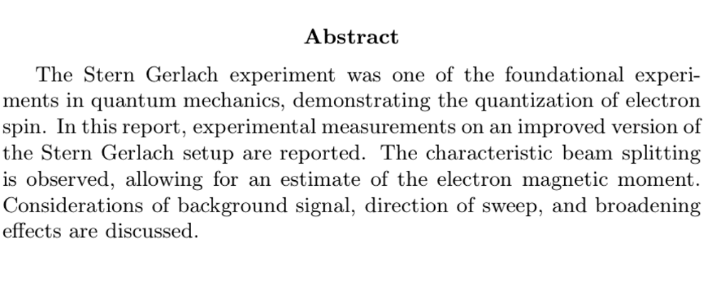
An example abstract (Stern-Gerlach)
Why
How
Results
So what
A question and its answer are missing.
Results are not specific and quantitative.

Slide 27
Introduction
~ 2 paragraph (=2 bullet points in the outline)
The context: what is known and unknown.
  Limitations and gaps in previous studies may motivate your question.
  Critical literature review is essential.
Your (burning) question and experimental approach.
  Why your experimental approach is new, and or important.

Slide 28
Model/ system
~3 paragraphs of relevant theory essential for communicating your question and its answer.
Stick to what is minimally necessary for the paper to be self-contained.
Diagram here (and figures elsewhere) should be self-contained. All the figures together with the title and abstract should tell your story.

Slide 29
Method
~ 3 para. Clear overview of what was done. Enough information (recipe) for replication.
Be complete, but minimize complexity.

Slide 30
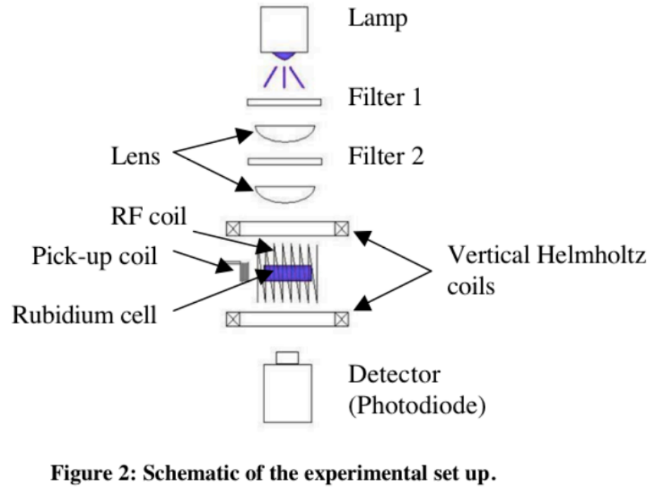
an example apparatus figure (optical pumping)
Pro: clear schematic view
Con: caption labels should be more informative.

Slide 31
Analysis and discussion
~6 para.
Goal: answer the question posed in the introduction in a logical and convincing manner.
Support your conclusion with detailed quantitative analysis.
Defend your conclusion and acknowledge limits
Highlight the implication: so what.

Slide 32
Figure guideline
Identify the specific topic or point of the figure. Plan figures as a part of outline.
Use sparingly. Cut unnecessary figures.
Use the same key terms in the title, captions and the text of the paper.
Caption and legends together should have
  Brief title.
  Experimental details
  Definition of symbols or line styles.
  Statistical information on the error bar.

Slide 33
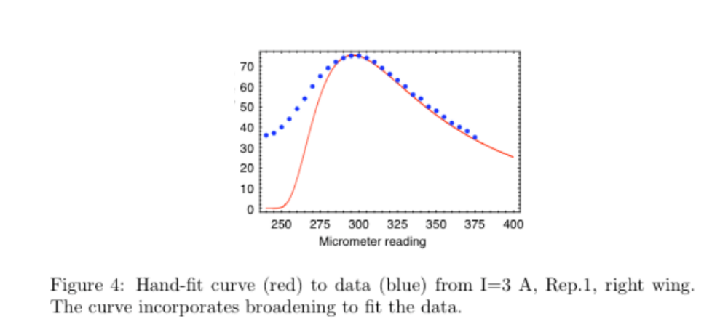
An example data plot (Stern-Gerlagh)
Pro: nice use of color and line style.
Con: the figure is too small, various elements are missing (e.g., error bars, units, axis label), the caption is incomplete.

Slide 34
Conclusion
~ 2 para.
Key finding (answer to the question)
Context:
  Compare with existing paradigms
  Explain unexpected or surprising findings
  Strengths and limitations
  End strong with “so what”. Leave an impression of your message.

Slide 35
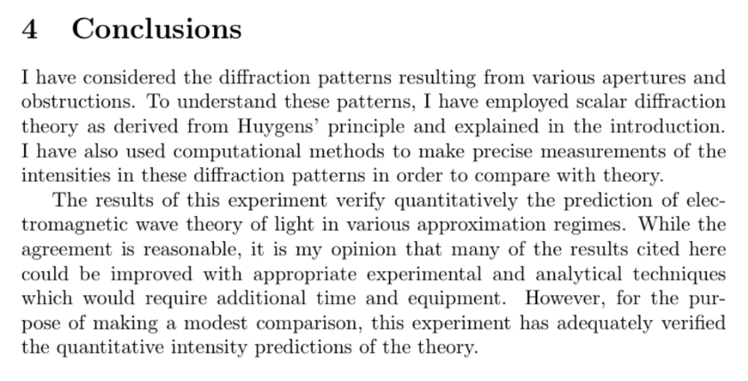
an example conclusion (diffraction)
Con: vague and obese.
Ex) Don’t use the word “quantitative”. Be quantitative.
Ex) Don’t write an entire paragraph which does not communicate anything.

Slide 36
References
Find and cite research articles and textbooks.
More than one perspective
Chris Henley’s three reasons for citing.

Slide 37
Constructing a paragraph
Each paragraph should be about one idea.
Present the main idea of the paragraph as the first sentence: topic sentence.
Follow with supporting idea and sub-supporting idea.
First and last sentences are most noticeable. Make them short and punch.

